Slide 1


Slide 2
CSS
CSS stands for Cascading Style Sheets
CSS defines how HTML elements are to be displayed
Styles were added to HTML 4.0 to solve a problem
External Style Sheets are stored in CSS files
CSS allow you to specify the style of page elements separately from structure of document.

Slide 3

CSS Syntax
A CSS rule set consists of a selector and a declaration block:
The selector points to the HTML element you want to style.
The declaration block contains one or more declarations separated by semicolons.
Each declaration includes a property name and a value, separated by a colon.

Slide 4
Three Ways to Insert CSS
There are three ways of inserting a style sheet:
External style sheet
Internal style sheet
Inline style
A CSS comment starts with /* and ends with */

Slide 5
External Style Sheet
With an external style sheet, you can change the look of an entire website by changing just one file!
Each page must include a reference to the external style sheet file inside the <link> element. The <link> element goes inside the head section:
<head>
<link rel="stylesheet" type="text/css" href="mystyle.css">
</head>

Slide 6
Internal Style Sheet
An internal style sheet may be used if one single page has a unique style.
    <html>
    <head>
    <style>
    h1 {
    color: maroon;
    margin-left: 40px;
    }
    </style>
    </head>
    <body>
    <h1>This is a heading</h1>
    </body>
    </html>

Slide 7
Inline Styles
An inline style may be used to apply a unique style for a single element.
<html>
<body>
<h1 style="color:blue;margin-left:30px;">
This is a heading.</h1>
<p>This is a paragraph.</p>
</body>
</html>

Slide 8
CSS id Selector
<html>
<head>
<style>
#para1 {
text-align: center;
color: red;
}
</style>
</head>
<body>
<p id="para1">Hello World!</p>
<p>This paragraph is not affected by the style.</p>
</body>
</html>

Slide 9
CSS Universal Selector
The universal selector (*) selects all HTML elements on the page.
<html>
<head>
<style>
* {
text-align: center;
color: blue;
}
</style></head>
<body>
<h1>Hello world!</h1>
<p>Every element on the page will be affected by the style.</p>
<b>Me too!</b>
<p>And me!</p>
</body></html>

Slide 10
CSS Grouping Selector
h1 {
text-align: center;
color: red;
}
h2 {
text-align: center;
color: red;
}
p {
text-align: center;
color: red;
}
h1, h2, p {
text-align: center;
color: red;
}

Slide 11
BACKGROUND PROPERTIES
CSS properties used for background effects:
background-attachment Sets whether a background image is fixed or scrolls with the rest of the page
background-color Sets the background color of an element
background-image Sets the background image for an element
background-position Sets the starting position of a background image
background-repeat Sets how a background image will be repeated

Slide 12
<style>
body {
background-image: url("gradient_bg.png");
background-repeat: repeat-x;
background-position: right top;
background-attachment: scroll;
}
</style>

Slide 13
TEXT FORMATTING
Text Color
The color property is used to set the color of the text.
h1
{ color:red;}
Text Decoration
The text-decoration property is used to set or remove decorations from text.

Slide 14
Text Transformation
The text-transform property is used to specify uppercase and lowercase letters in a text.
text-transform: uppercase;
text-transform: lowercase;
text-transform: capitalize;
FONT FAMILY
font-family: Times New Roman

Slide 15
The CSS Box Model
All HTML elements can be considered as boxes. In CSS, the term "box model" is used when talking about design and layout.
The CSS box model is essentially a box that wraps around HTML elements, and it consists of: margins, borders, padding, and the actual content.
The box model allows us to add a border around elements, and to define space between elements.

Slide 16
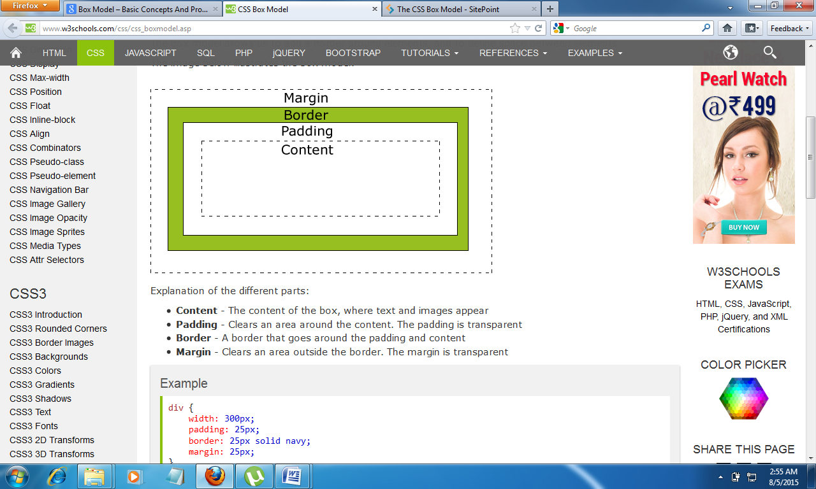
The image below illustrates the box model:

Slide 17
Explanation of the different parts:
Content - The content of the box, where text and images appear
Padding - Clears an area around the content. The padding is transparent
Border - A border that goes around the padding and content
Margin - Clears an area outside the border. The margin is transparent

Slide 18
MARGIN
It can be used to describe margin for the data
  margin-top
  margin-left
  margin-right
  margin-bottom

Slide 19
BORDER
border-style values:
  none: Defines no border
  dotted: Defines a dotted border
  dashed: Defines a dashed border
  solid: Defines a solid border
  double: Defines two borders. The width of the two borders are the same as the border-width value
  groove: Defines a 3D grooved border. The effect depends on the border-color value
  ridge: Defines a 3D ridged border. The effect depends on the border-color value
  inset: Defines a 3D inset border. The effect depends on the border-color value
  outset: Defines a 3D outset border. The effect depends on the border-color value

Slide 20
Border Width
The border-width property is used to set the width of the border.
The width is set in pixels, or by using one of the three pre-defined values: thin, medium, or thick.
Border Color
The border-color property is used to set the color of the border. The color can be set by:
    name - specify a color name, like "red"
    RGB - specify a RGB value, like "rgb(255,0,0)"
    Hex - specify a hex value, like "#ff0000"
You can also set the border color to "transparent".
If the border color is not set it is inherited from the color property of the element.

Slide 21
Border - Individual sides
In CSS it is possible to specify different borders for different sides:
    <html>
    <head>
    <style>
    p {
    border-top-style: dotted;
    border-right-style: solid;
    border-bottom-style: dotted;
    border-left-style: solid;
    }
    </style>
    </head>
    <body>
    <p>2 different border styles.</p>
    </body>
    </html>

Slide 22
The border-style property can have from one to four values.
border-style: dotted solid double dashed;
  top border is dotted
  right border is solid
  bottom border is double
  left border is dashed
border-style: dotted solid double;
  top border is dotted
  right and left borders are solid
  bottom border is double
border-style: dotted solid;
  top and bottom borders are dotted
  right and left borders are solid
border-style: dotted;
  all four borders are dotted

Slide 23
PADDING:
The padding clears an area around the content (inside the border) of an element. The padding is affected by the background color of the element.
The top, right, bottom, and left padding can be changed independently using separate properties.
Possible Values
1.length
Defines a fixed padding (in pixels, pt, em, etc.)
2.%
Defines a padding in % of the containing element

Slide 24
    <html>
    <head>
    <style>
    p {
    background-color: yellow;
    }
    p.padding {
    padding-top: 25px;
    padding-right: 50px;
    padding-bottom: 25px;
    padding-left: 50px;
    }
    </style>
    </head>
    <body>
    <p>This is a paragraph with no specified padding.</p>
    <p class="padding">This is a paragraph with specified paddings.</p>
    </body>
    </html>

Slide 25
The padding property can have from one to four values.
padding: 25px 50px 75px 100px;
  top padding is 25px
  right padding is 50px
  bottom padding is 75px
  left padding is 100px
padding: 25px 50px 75px;
  top padding is 25px
  right and left paddings are 50px
  bottom padding is 75px
padding: 25px 50px;
  top and bottom paddings are 25px
  right and left paddings are 50px
padding: 25px;
  all four paddings are 25px

Slide 26
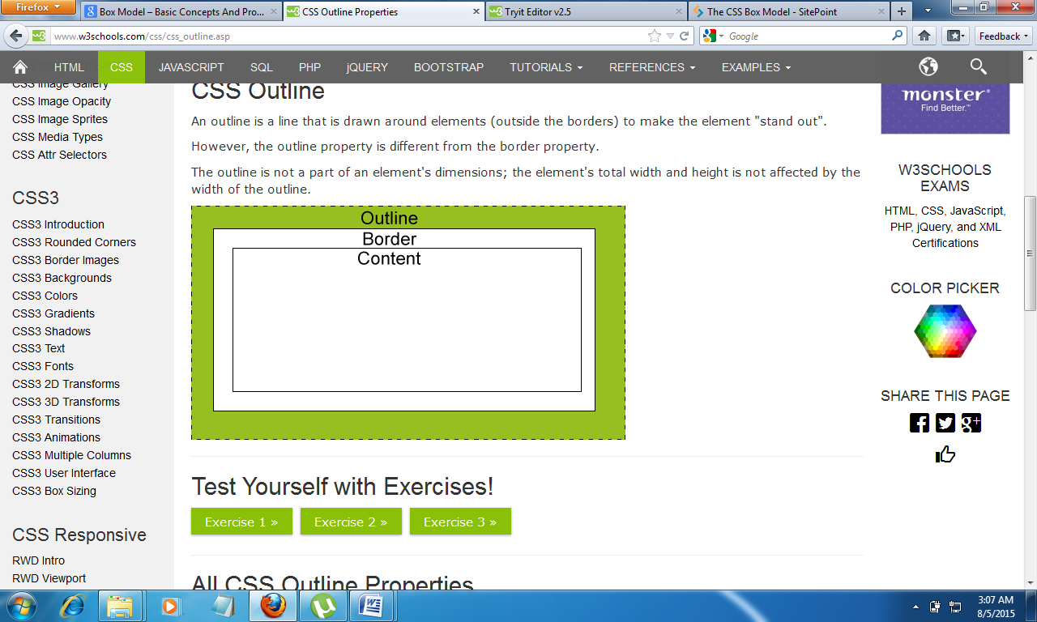
CSS Outline
An outline is a line that is drawn around elements (outside the borders) to make the element "stand out".
However, the outline property is different from the border property.
The outline is not a part of an element's dimensions; the element's total width and height is not affected by the width of the outline.

Slide 27
CSS LINKS
a:link {
color: red;
}
/* visited link */
a:visited {
color: green;
}
/* mouse over link */
a:hover {
color: yellow;
}
/* selected link */
a:active {
color: blue;
}

Slide 28
CSS Opacity / Transparency
The opacity property specifies the opacity/transparency of an element.
Transparent Image
The opacity property can take the values from 0.0-1.0. The lower value the more transparent
<html>
<head>
<style>
img {
opacity: 0.5;
}
</style>
</head>
<body>
<p>Image with 50% opacity:</p>
<img src="images1.jpg" alt="Forest" width="170" height="100">
</body>
</html>

Slide 29
Transparent hover effect
img {
opacity: 0.5;
}
img:hover {
opacity: 1.0;
}

